Slide 1
Evaluating Machine Learning Approaches for ASCII Art Generation
Pranav Akiri

Slide 2
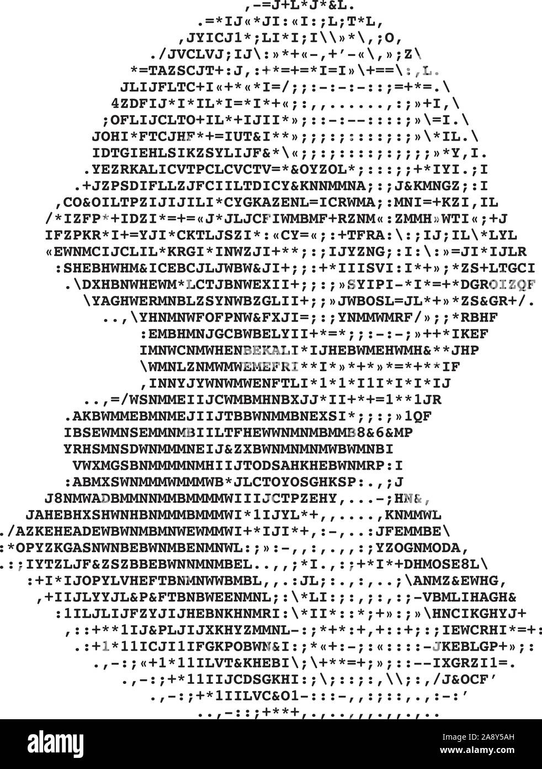
Background
ASCII → American Standard Code for Information Interchange
ASCII art is typically created by mapping grayscale pixel values to ASCII characters
@ is “darker” than -
ML models are used to classify image segments into ASCII characters instead

Slide 3

Dataset
Past research (Akiyama 2017) has entirely recreated line structures of numerous ASCII art images and further segmenting them into smaller tiles to make the dataset, which can be time-intensive
Dataset was created by taking random samples of ASCII character image tiles, applying transformations, and assigning each character to a corresponding image
Gaussian blur, random noise
Numerous classes corresponding to each possible ASCII character
→ /
→ —

Slide 4
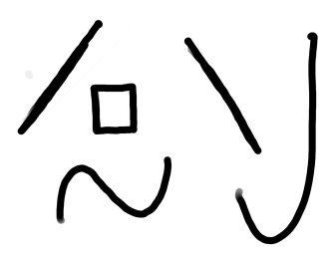
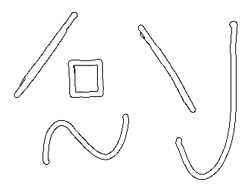
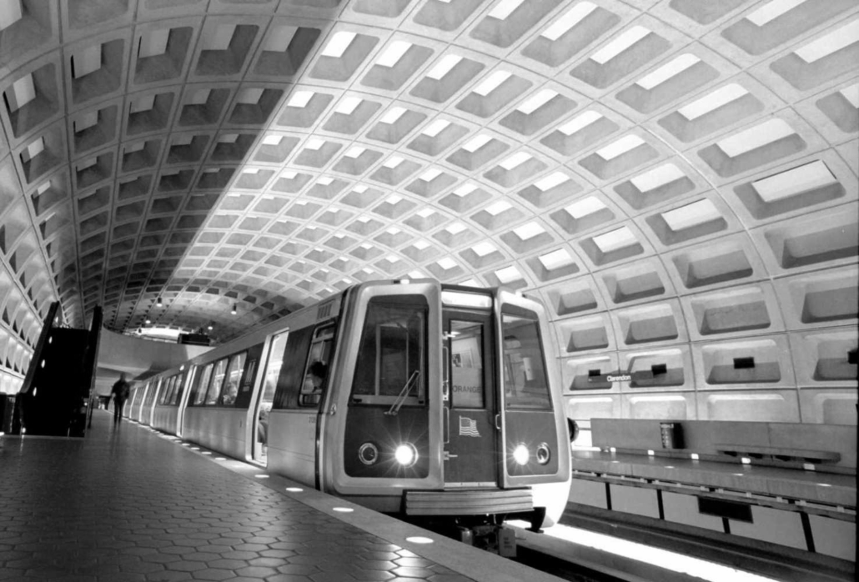
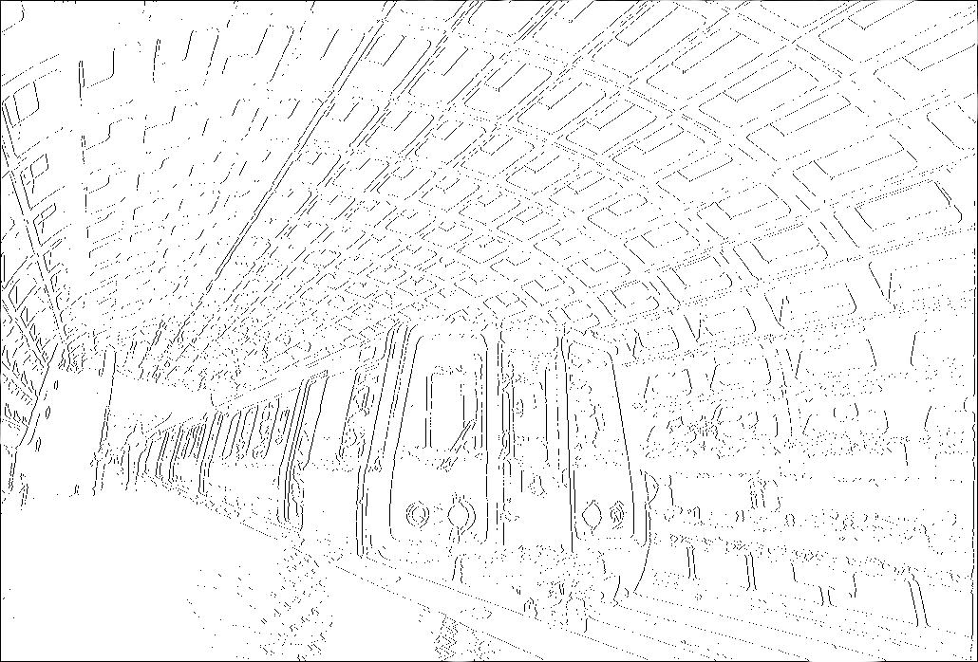
Preprocessing
Images are blurred using a Gaussian blur then Canny edge detection is used to mark lines
Resizing to ensure resulting ASCII image doesn’t look stretched
Image is divided into 10 x 10 tiles (past research (Akiyama 2017) has used 64 x 64 tiles)
Visual outputs were better with the smaller tile size

Slide 5
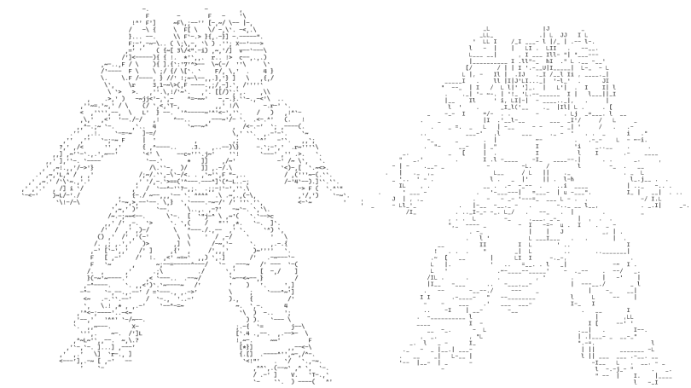
Outputs with Different Tile Sizes
KNN with 10 x 10 image tiles
KNN with 64 x 64 image tiles

Slide 6
Models
KNN
Data point is classified based on the 5 nearest neighbors (k = 5)
Each data point consists of image pixel values with the associated ASCII character as the label
SVM
Kernel trick is used to separate overlapping data
Hyperplane classifies data points between the two closest matches
Random Forest
100 decision trees, each running through several possible ASCII character options
All models were run using scikit-learn with default parameters

Slide 7

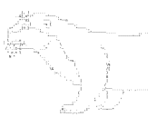
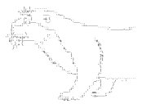
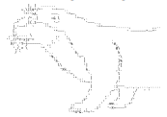
Results
Original Image with Canny
KNN
SVM
Random Forest

Slide 8
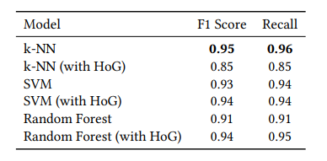
Performance Metric Results
KNN outperforms SVM and Random Forest in both F1 Score and Recall
Relies on majority voting instead of binary separation

Slide 9
Novelty & Conclusion
Combines computer vision with machine learning to produce well-performing results
Use of machine learning models for image processing tasks
Classical machine learning methods, like Random Forest, are applied to a context they’re not used as much in yet perform well
Deep learning models do not always give better results than regular machine learning models and machine learning models like KNN, SVM, and Random Forest are well equipped for certain problems in other fields of artificial intelligence

Slide 10
Related Work
Akiyama 2017 - “ASCII Art Synthesis with Convolutional Networks”
Focuses on the use of convolutional neural networks (CNNs) specifically to make ASCII art images
CNN performance was somewhat worse, perhaps due to using larger image tiles
Xuemiao et al. 2016 - “ASCII Art Synthesis from Natural Photographs”
Utilizes a non-CRF (classical receptive field) model and separates data that perceptrons might find hard to distinguish with normal data for better results
This approach does not use any of the ML models we learned but it does show that there are more bespoke ways to create ASCII art

Slide 11
Sources
Akiyama, O. (2017). ASCII Art Synthesis with Convolutional Networks. https://www.semanticscholar.org/paper/ASCII-Art-Synthesis-with-Convolutional-Networks-Akiyama/eb23e948e576e96fd138e85e13bcec9f93aacda7
Coumar, S., & Kingston, Z. (2025, March 18). Evaluating Machine Learning Approaches for ASCII Art Generation. https://doi.org/10.48550/arXiv.2503.14375
Xu, X., Zhong, L., Xie, M., Liu, X., Qin, J., & Wong, T.-T. (2016, June 14). ASCII Art Synthesis from Natural Photographs. https://ieeexplore.ieee.org/document/7491376

